Slide 1


SADMA: Scalable Asynchronous Distributed
Multi-Agent Reinforcement Learning Training Framework
Sizhe Wang∗, Long Qian∗, Cairun Yi, Fan Wu, Qian Kou, Mingyang Li, Xingyu Chen, and Xuguang Lan†
Institute of Aritificial Intelligence and Robotics, Xi’an Jiaotong University
* : Equal contributions † : Corresponding author

Slide 2



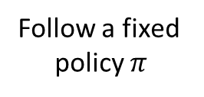


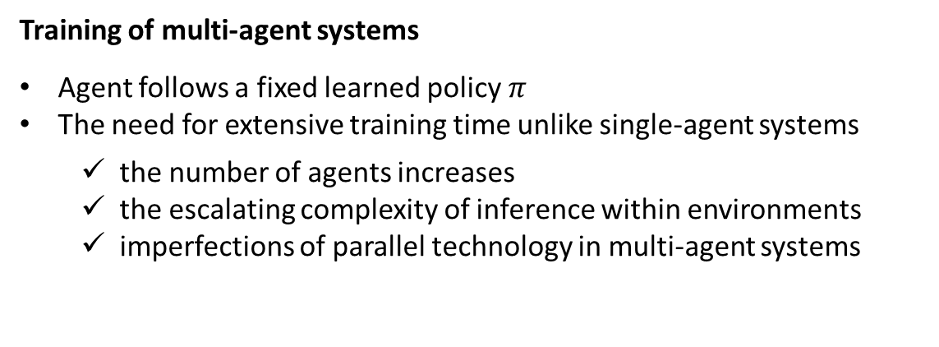
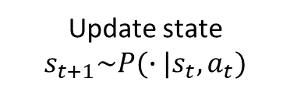
Introduction
Time-consuming training in multi-agent systems
Training of multi-agent systems
Agent follows a fixed learned policy$π$
The need for extensive training time unlike single-agent systems
the number of agents increases
the escalating complexity of inference within environments
imperfections of parallel technology in multi-agent systems
Follow a fixed
policy $π$
Observe state $s_{t}$
Update state
$$s_{t+1}\sim P(∙|s_{t},a_{t})$$
Take action $a_{t}\sim π(∙|s_{t})$
…
Receive reward $R(s_{t},a_{t})$
2
Notes:
Reinforcement learning is a machine learning paradigm that focuses on interactive learning between an agent and its environment. By observing the state of the environment, performing actions, and receiving rewards, the agent gradually learns to choose the optimal action strategy to maximize future accumulated rewards.
Multi-agent reinforcement learning extends this concept further, where multiple agents learn and interact in the same environment simultaneously. MARL has achieved remarkable success in many real-world decision-making problems that involve multi-agent systems across various domains, such as multi-player strategy games, network routing, and autonomous driving.
However, due to the involvement of interactions and cooperation among multiple agents, MARL environments tend to be extremely complex. Furthermore, as the number of agents increases, the speed of interaction with environments may severely decrease due to the escalating complexity of inference within environments.

Slide 3
Introduction
Framework and methods to shorten training time
Using multiprocessing techniques
Existing multi-agent reinforcement learning libraries such as PyMARL and PyMARL2
The shortcomings of these frameworks
lack of expansion to multi-machine resources
run very slowly when confronted with large-scale complex multi-agent environments
Using Ray as a distributed framework
Algorithm libraries using Ray as a distributed framework such as RLlib and MARLlib
The shortcomings of these frameworks
lack of flexible and scalable distributed training solutions
unable to fully utilize distributed GPU resources to accelerate training
3
Notes:
In order to reduce training time, some researchers have suggested running multiple instances of the environment in parallel using multiprocessing techniques to improve the sample efficiency. Existing multi-agent reinforcement learning libraries such as PyMARL and PyMARL2 utilize python’s multiprocess programming technique to realize environment parallelism. However, when confronted with large-scale complex multi-agent environments, environment instances may run very slowly and consume a lot of resources. Limited by the computational resources of a single machine, simple environment parallelism still cannot fulfill the demand.
There are also some algorithm libraries that use Ray as a distributed framework, such as RLlib and MARLlib. Although the algorithm can be extended to multiple machines, they focus on the encapsulation and integration of algorithms and environments and do not provide diversity for multi-agent reinforcement learning algorithms a centralized and flexible distributed training solution

Slide 4
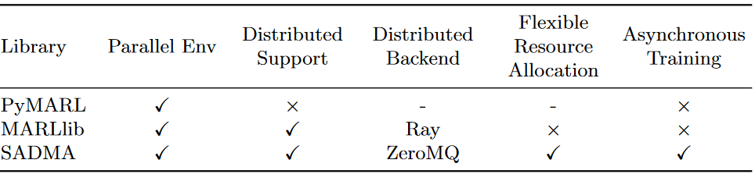
Introduction
Core challenges and our solutions
Core challenges
Extend multi-agent reinforcement learning training to multi-machine distribution
Effectively harnessing cluster computing resources to expedite training
Our proposed framework : Scalable Asynchronous Distributed Multi-Agent RL training framework called SADMA
Address the problem of efficient acceleration of distributed training in large-scale multi-agent reinforcement learning training scenarios
use efficient distributed parallel sampling and asynchronous training
decouple and modularize the MARL training process
design efficient and unified data transfer interfaces for cross-process and cross-machine communication
Comparison of SADMA with other multi-agent reinforcement learning libraries
4
Notes:
In summary, In the context of large-scale MARL training, effectively harnessing cluster computing resources to expedite training becomes a critical concern. To address these challenges, we propose Scalable Asynchronous Distributed Multi-Agent RL training framework called SADMA.
The advantages of our framework are as follows:
We use efficient distributed parallel sampling and asynchronous training to further reduce the waiting time during the training process.
We decouple and modularize the MARL training process
In addition, we design efficient and unified data transfer interfaces for cross-process and cross-machine communication, bringing flexibility and scalability to distributed deployments.

Slide 5
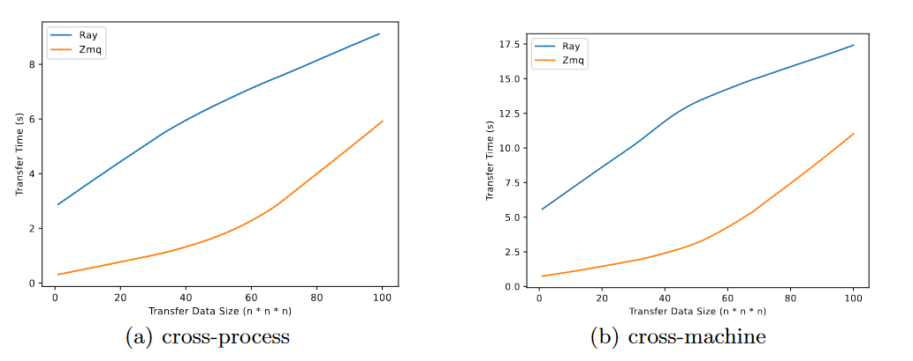
Framework Design
High-Performance Data Transfer Scheme
Cross-Process Data Transfer
CPU-side data : build pipes for inter-process data transfer
Special: utilize shared memory for frequently read and written data
GPU-side data : utilize transfer pointers to transfer data transfers
Cross-Machine Data Transfer
ZMQ : a lightweight messaging library
With the advantages of flexibility, reliability, high-performance and lightweight compared to Ray
Cross-process and cross-machine data transfer speed comparison between ZMQ and Ray
5
Notes:
Next, I will introduce the overall design and features of SADMA in detail.
First, based on multi-process techniques and the asynchronous messaging library ZMQ, we build a unified data transfer interface to facilitate efficient communication between processes to achieve compatibility with cross-process and cross-machine data transfer.
We use cross-process data transfer scheme for modules running on the same machine. To handle CPU-side data, we utilize shared memory for frequently read and written data. As for GPU-side data, which are shared across processes, we exclusively transfer pointers to circumvent resourceintensive data transfers.
We employ ZMQ, a lightweight and highperformance messaging library, to facilitate more expedited cross-machine data transfer.We conduct a comparative analysis of the cross-machine transfer efficiency between ZMQ and Ray for various data sizes. Fig.shows that ZMQ is more efficient than Ray for both cross-process and cross-machine communication, especially for cross-machine transfers. This supports our choice of ZMQ as the efficient data transfer scheme.

Slide 6
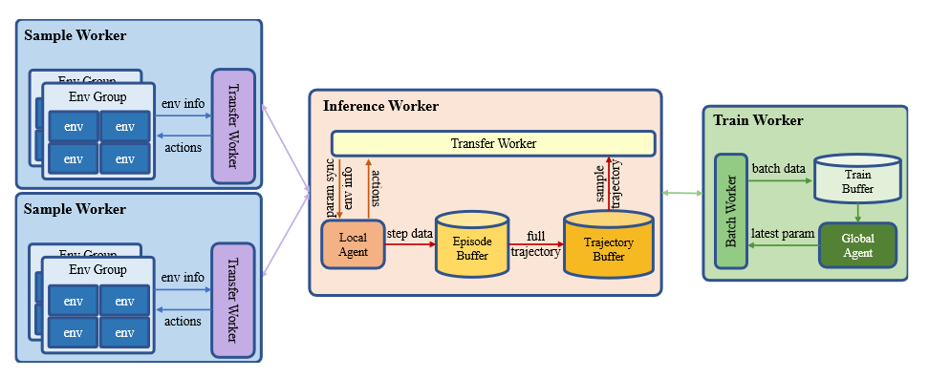
Framework Design
Modularize the training process
In order to support distributed training, we modularize the training process so as to fully utilize the computational resources to run each module asynchronously to reduce the waiting time, improve the overall training speed and achieve good scalability.
Code is available at https://github.com/sadmaenv/sadma.
Framework Overview
6
Notes:
In order to support distributed training, we modularize the training process so as to fully utilize the computational resources to run each module asynchronously to reduce the waiting time and improve the overall training speed. Our overall modularized design is shown in Fig.
We modularize the training process into 5 parts, namely Transfer Worker, Sample worker, Inference Worker, Batch worker and Train Worker.

Slide 7
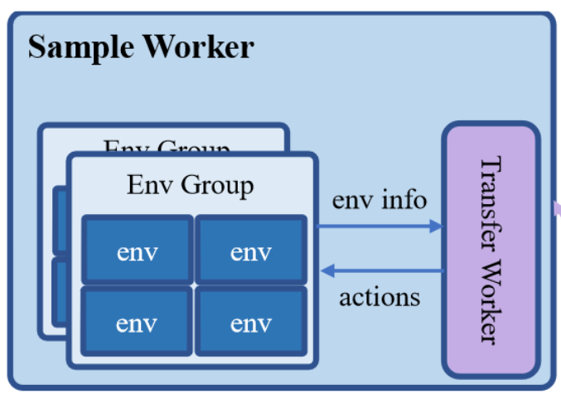
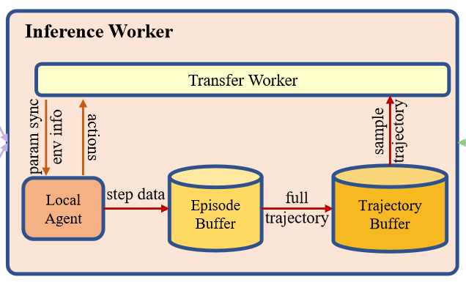
Framework Design
Modularize the training process
Sample Worker : manage the interactions of multiple parallel environments
Inference Worker : manage the policy inference to provide actions for interacting with the environment
6
Notes:
Large-scale MARL tasks typically require massive amounts of interaction data for training. However, due to limitations in the inference speed of the environments, running a single environment for data sampling cannot efficiently provide the required training data in a timely manner. Hence, we construct the sample worker which is responsible for managing the interactions of multiple parallel environments and separate asynchronously environment interaction and policy inference. Since policy inference involves neural network computation, which generally requires GPU, while environment execution only requires CPU, we can flexibly allocate computing resources to the inference worker and sampler worker for different cluster configurations to fully utilize the cluster resources.
The inference worker is responsible for policy inference to provide actions for interacting with the environment. The inference worker creates the episode buffer for each environment it is responsible for, since complete episodes are often used as training data in MARL algorithms such as QMIX.

Slide 8
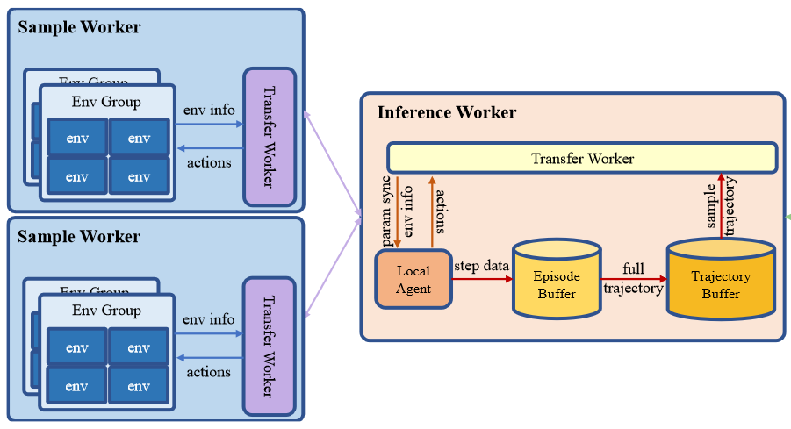
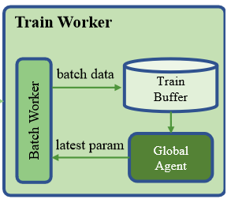
Framework Design
Modularize the training process
Transfer Worker : manage the cross-machine or cross-process data transfer between modules
Batch Worker & Train Worker : consolidate episode data from each inference worker into a batch and manage the agent training and synchronization
6
Notes:
In order to facilitate inter-module data transfer, we develop the transfer worker based on the unified transfer interface. The transfer Worker is responsible for cross-machine or cross-process data transfer between modules. It operates within a separate process ,eliminating data waiting times that could otherwise impact the main program’s execution.
The batch worker’s role is to consolidate episode data from each inference worker into a batch and then transfer this batched data onto the GPU, placing it into the train buffer. The train worker, in turn, retrieves the training data directly from the GPU using data addresses. The role of the train worker primarily centers around agent training and synchronization. With the presence of a batch worker, the train worker is relieved from the burden of tedious data processing. This streamlined workflow enables the train worker to devote undivided attention to agent training, resulting in improved efficiency

Slide 9
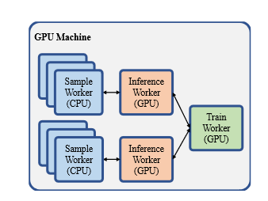
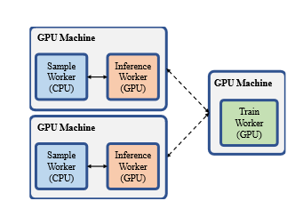
Framework Design
Flexible Resource Allocation
Benefiting from the modularized design and unified data transfer interface, each module can be flexibly combined with each other and assigned to different computing nodes in the cluster so that our framework can fully utilize cluster resources to accelerate training.
1-GPU machine : Data does not need to be transmitted across machine, only needs to be considered for cross-process transfer
n-GPU machine : Framework can run multiple parallel environments with multiple inference modules on a single GPU node, and then run train modules on another GPU node.
7
Notes:
Benefiting from the modularized design and unified data transfer interface, each module can be flexibly combined with each other and assigned to different computing nodes in the cluster so that our framework can fully utilize cluster resources to accelerate training. In the following we describe in detail several different configuration types supported by our framework.
The first is 1-GPU machine mode. Considering that a single machine,as shown in Fig, the data between modules does not need to be transferred based on the network, but only needs to be considered for cross-process transfer. We use inter-process pipelines and shared memory to realize the communication, which ensures the efficiency of training.
The second is n-GPU machine mode. When all the computing nodes in the cluster have GPUs, our framework can more fully utilize GPU resources to accelerate training unlike MARLlib which is unable to utilize distributed GPU resources. Since the modules can be freely combined, we can run the parallel environment and the corresponding inference modules on multiple GPU nodes, as shown in Fig.
We can run multiple parallel environments with multiple inference modules on a single GPU node, and try to place each inference module on a different GPU card so as to make the load of GPU cards as balanced as possible.

Slide 10
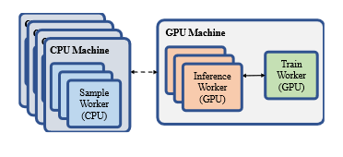
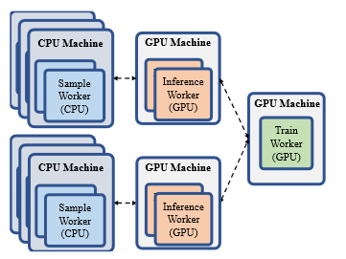
Framework Design
Flexible Resource Allocation
1-GPU & n-CPU Machines : Framework can run parallel environment instances on CPU nodes. Then the others are placed on the single GPU node.
n-GPU & m-CPU Machines : Framework can run parallel environment instances on CPU nodes and then run inference modules and train modules on different GPU nodes.
8
Notes:
Next is 1-GPU & n-CPU Machines mode, when there are limited GPU computing nodes, for example, there is only one GPU node and the rest are CPU nodes, as shown in Fig. In this case, the training module and the inference module can be placed on the GPU at the same time or only the training module can be placed on the GPU. Both have their own advantages and disadvantages. Our framework can be flexibly adapted. We only need to modify the configuration file and no additional code changes are required.
Finally, there is n-GPU & m-CPU Machines mode, when all the computing nodes in the cluster have GPUs, our framework can more fully utilize GPU resources to accelerate training unlike MARLlib which is unable to utilize distributed GPU resources.

Slide 11
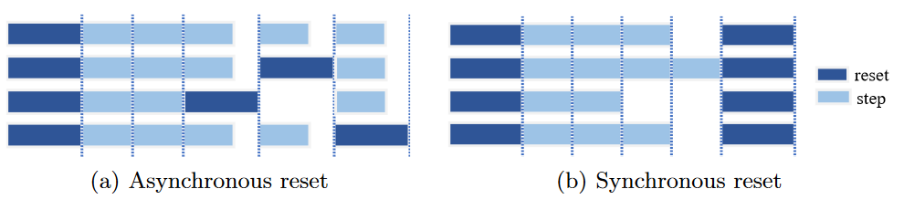
Framework Design
High-Performance Specific Optimization
Synchronous & Asynchronous Environment Reset
We implemented two environments reset modes to flexibly respond to different environmental situations.
In synchronous reset mode, framework wait for the end of the episodes of all environments before resetting them
In asynchronous reset mode, framework reset an environment as soon as its episode ends
Synchronous and asynchronous environment reset
9
Notes:
To address the training process as well as our distributed framework, we use a series of targeted performance optimizations to improve the sampling speed and training speed. The specific optimization scheme is as follows.
The first is Synchronous & Asynchronous Environment Reset, Our framework supports both synchronous and asynchronous environment reset modes. In synchronous reset mode, framework wait for the end of the episodes of all environments before resetting them. In asynchronous reset mode, framework reset an environment as soon as its episode ends. When environment reset consumes a lot of time, it is suitable to adopt synchronous reset mode, while when environment reset consumes little time, it is advantageous to adopt asynchronous reset mode. Our framework supports both modes to deal with different application scenarios.

Slide 12
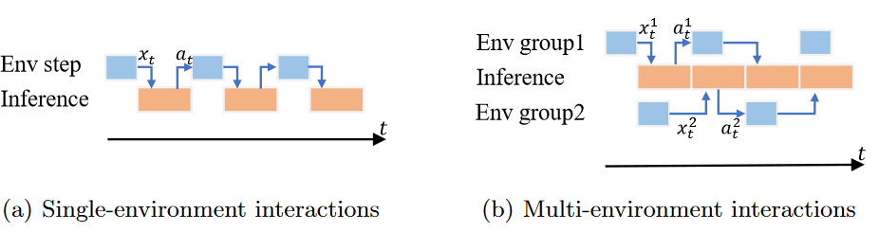
Framework Design
High-Performance Specific Optimization
Multi-Environment Group
We use multi-environment groups to divide the environments managed in the sample worker into multiple groups. In this way, we can save some inference and data transmission overhead
Single-environment and multi-environment group interactions
10
Notes:
The second is Multi-Environment Group. The problem with synchronized environment interaction is that there is a sequential relationship between environment execution and policy inference. This results in sample workers and inference workers always having idle time and not being able to fully utilize compute resources. In order to achieve more efficient environment interaction, we use multi-environment groups to divide the environments managed in the sample worker into multiple groups, as shown in Fig.. When an environment group returns the environment information and waits for the inference worker’s inference data, the rest of the environment groups perform the environment execution. When the inference worker finishes the inference, the rest of the environment groups will transfer the environment information immediately, so that the inference worker will not be in an idle state.

Slide 13
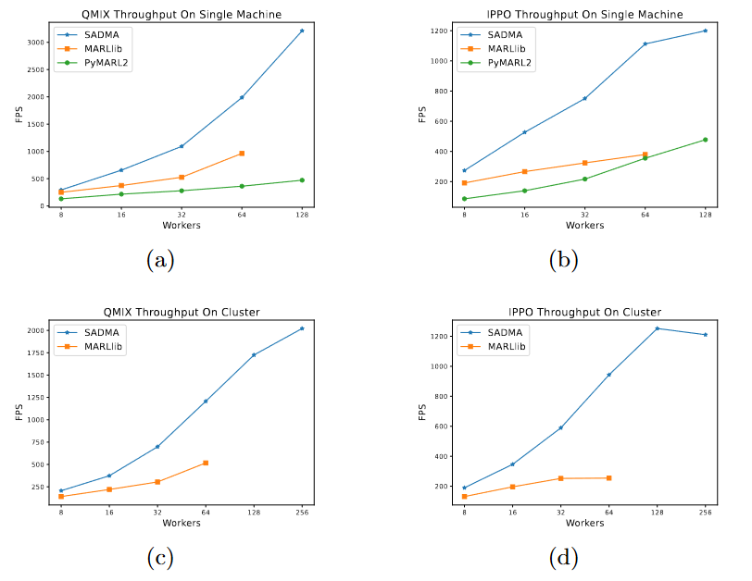
Experiments
Throughput Comparisons
Throughput measures the sampling speed of the framework, which affects the overall training efficiency.
Faster sampling speed reduces waiting time by providing the sample data needed for training in time
Experiment parameters :
Environment : 27m vs 30m map in SMAC
Algorithms : IPPO and QMIX
CPU core utilization : From 1 to 256
Result :
Benefiting from the asynchronous training process and targeted optimization schemes, our framework can achieve higher sampling speeds.
11
Notes:
We evaluate the performance of the proposed SADMA framework. We choose to compare it with PyMARL2, a classic single-computer multi-agent reinforcement learning algorithm library, and MARLlib, the latest MARL algorithm library with distributed support, as baselines. In order to fully demonstrate the advantages of our framework, we test the efficiency under different computational resource scenarios on single-machine and multi-machine settings respectively.
The first is Throughput Comparisons experiment, Throughput measures the sampling speed of the framework, which affects the overall training efficiency. Faster sampling speed reduces waiting time by providing the sample data needed for training in time. We compare to baselines under different resource configurations for single and multiple machines settings.
We choose the classical multi-agent reinforcement learning environment SMAC for testing. To increase the complexity of the environment interaction, we choose 27m vs 30m map in SMAC. Considering that multi-agent reinforcement learning includes on-policy algorithms like IPPO and off-policy algorithms like QMIX, these two categories of algorithms have different sampling processes, which may lead to different sampling speeds. We separately test the throughput under these two types of algorithms. In order to compare the sampling speed under different computational resource conditions, we gradually increase the CPU core utilization from 1 to 256 to test the throughput.
Fig. shows the comparison results. The horizontal coordinate represents the number of CPU cores used for sampling, with each core running one environment instance. Due to the high GPU memory usage of MARLlib, there is a memory overflow when setting the number of workers to 128, so we only tested to 64 workers. It can be seen that the sampling speed of our framework is excellent on both single and multiple machines

Slide 14
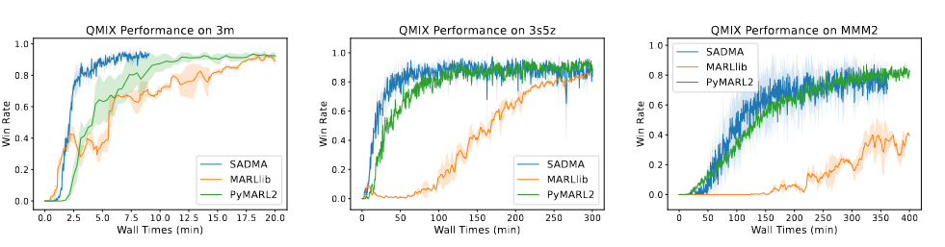
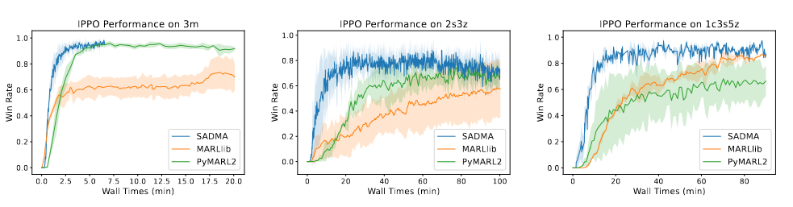
Experiments
Convergence Acceleration
Throughput measures the sampling speed of the framework, which affects the overall training efficiency.
Faster sampling speed reduces waiting time by providing the sample data needed for training in time
Experiment parameters :
Environment : SMAC
Algorithms : IPPO and QMIX
Configuration : Single-machine
Result :
Benefiting building an asynchronous training flow through efficient inter-process communication, our curves are always above PyMARL2 and MARLlib.
12
Notes:
Although our framework has a higher sampling speed, it remains a question whether this is effective in improving the wall times necessary for the algorithm to converge. Therefore, we compare the wall times of each framework to make the algorithm converge with the same resource configuration. For comparison with the convergence performance of the algorithm in PyMARL2, we test it on the single-machine configuration. We choose several maps in SMAC to test the convergence speed of each framework with the QMIX and IPPO algorithms.
We uniformly set the number of workers to 8 and ensure that other parameters are consistent. Fig show the convergence of the QMIX and IPPO algorithm in each framework on different maps respectively. It can be seen that our curves are always above PyMARL2 and MARLlib, which indicates that our framework is able to effectively utilize the computational resources to improve the convergence speed of the algorithms under the same resource configuration.

Slide 15
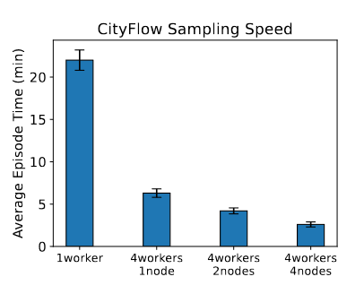
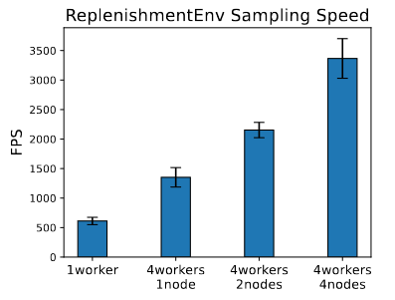
Experiments
Scalability Evaluation
We constructed an environment containing 1225 agents based on the CityFlow environment where the agent need to control the flow of traffic at each intersection, as well as a replenishment environment containing 1000 agents where the agent need to control the transaction of goods between different warehouses.
Distributed sampling speed with different resource configurations
Result :
Show the sampling speed up obtained by allocating different computational resources.
Easily implement distributed scaling to accelerate training and powerful scalability and compatibility provide an efficient solution for research on large-scale complex multi-agent tasks.
13
Notes:
In order to evaluate the scalability of SADMA for large-scale multi-agent environments, we constructed an environment containing 1225 agents based on the CityFlow environment, where the agent need to control the flow of traffic at each intersection, as well as a replenishment environment containing 1000 agents, where the agent need to control the transaction of goods between different warehouses. Due to the large number of agents, running an episode of the environment takes a lot of time and memory. At the same time, singlestep policy inference needs to compute the actions of all the agents, which leads to slower inference and larger GPU memory usage.
Fig. shows our framework can achieve distributed scalability for these two complex multi-agent environments to accelerate training.

Slide 16
Conclusion
Advantages and future work
Scalability : Our framework is designed to be deployed in large-scale clusters, allowing efficient utilization of computational resources thus achieving significant training acceleration.
Modularization : We modularize the MARL training process to simplify algorithms construction and provide support for distributed training.
Asynchronicity : We decouple the modules to run the sampling and training process asynchronously, reducing the waiting time to achieve higher resource utilization and runtime speeds.
Flexibility : Modules can be combined and flexibly deployed anywhere in the cluster to adapt to various cluster resource configurations.
Future work
In future work, we will continue to add different multi-agent environments and multi-agent reinforcement learning algorithms to our framework. We will also continue to look for improvements in framework scalability and speed.
14
Notes:
Furthermore, our framework is easy to use and deploy, and with the help of deployment systems such as Kubernetes , it is possible to efficiently run distributed training tasks in large-scale clusters. Our framework offers the following advantages:
Scalability : Our framework is designed to be deployed in large-scale clusters, allowing efficient utilization of computational resources thus achieving significant training acceleration.
Modularization : We modularize the MARL training process to simplify algorithms construction and provide support for distributed training.
Asynchronicity : We decouple the modules to run the sampling and training process asynchronously, reducing the waiting time to achieve higher resource utilization and runtime speeds.
Flexibility : Modules can be combined and flexibly deployed anywhere in the cluster to adapt to various cluster resource configurations.
In future work, we will continue to add different multi-agent environments and multi-agent reinforcement learning algorithms to our framework. We will also continue to look for improvements in framework scalability and speed.

Slide 17
Thanks for listening
Contact Information :
Sizhe Wang (Master student) : wangsizhe@stu.xjtu.edu.cn
Prof. Xuguang Lan : xglan@xjtu.edu.cn

